Slide 1

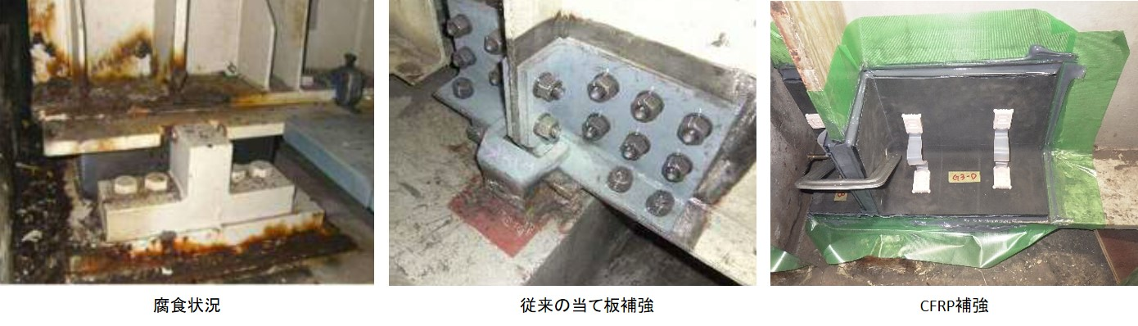
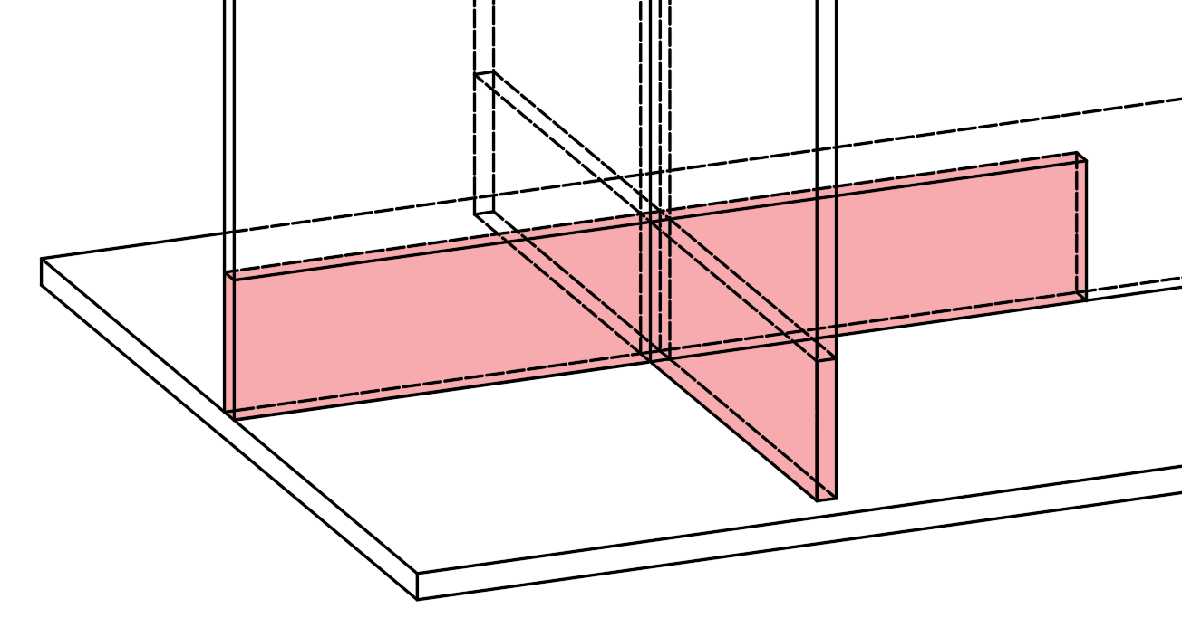
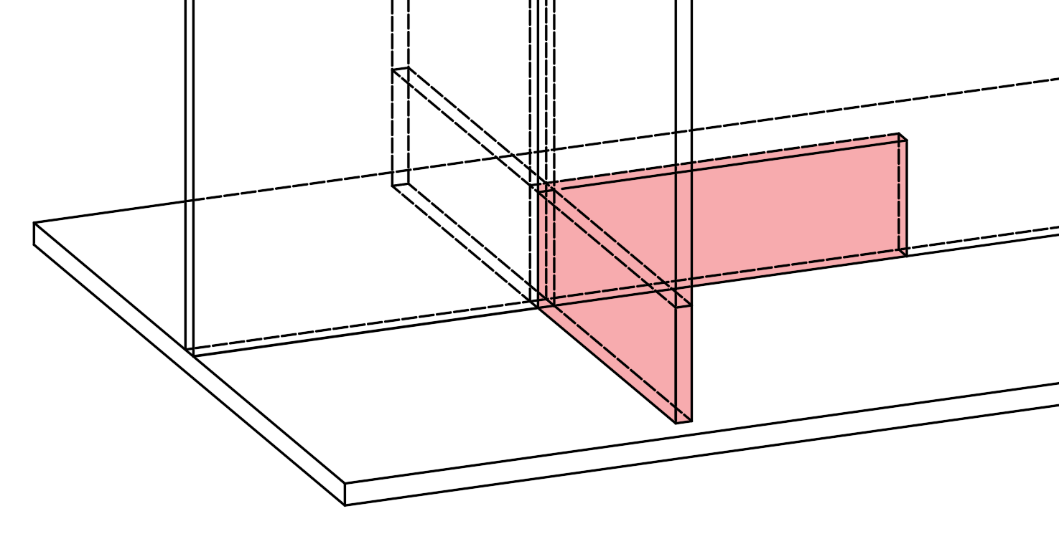
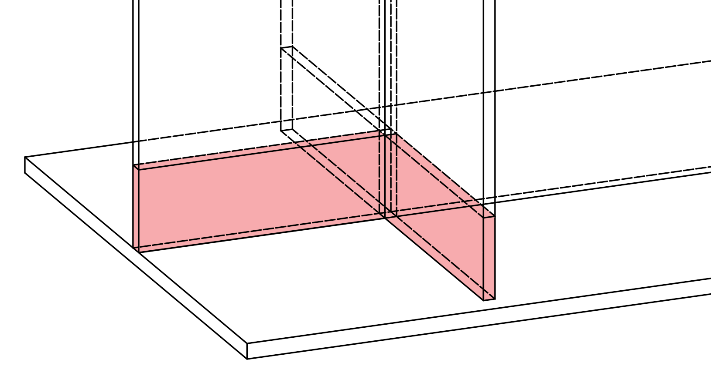
Versatile and Quick-response Repair of Corroded I-shaped Girder Ends with Doubler Plates and High-strength Bolts
Osaka Metropolitan University Graduate School of Engineering Bridge Engineering Lab Taishi INOUE
Analytical Study on the Repair Effect of Using Similar Doubler Plates
BACKGROUND
RESULTS
It was set to 1257 kN, obtained by dividing the design yield resistance by a partial factor of 1.36, focusing on quick- response repair in an emergency situation.
Corroded I-shaped girder ends have recently been repaired with double plates and high-strength bolts as a countermeasure against corrosion caused by water leakage and confined spaces. This repaired part should be versatile, that is, designed with strengthening and stiffening effects, resilience, workability, and cost-effectiveness in mind as corrosion distribution and extent are various.
Recovery Target
Proportional limit load shall exceed the target recovery load.
The vertical shortening of the cruciform column at the target recovery load shall not exceed that of the intact condition (0.9 mm).
All cases satisfied the recovery target.
The recovery performance is evaluated in other corrosion conditions.
Purpose
Repair effect evaluation of kitted doubler plates under several corrosion pattern
In all cases, proportional limit load was lower than the design yield resistance of the cruciform column.
Fig. 1 Corrosion Damage and Doubler Plate Repair
METHOD
Corrosion Area
Unit : mm
Stress concentration occurs above the sole plate's end due to a contact force, whose degree of freedom is linked by the MPC beam constraint at the reference point. This phenomenon reduces the proportional limit load.
300 mm
100 mm
DMG1
DMG2
Fig. 5 Load–Displacement Relationship
Table. 1 Recovery Assessment Results
Unit : N/mm²
DMG3
DMG4
Fig. 4 Doubler Plate Dimensions
Fig. 3 Corrosion Case
Corrosion Case:
DMG1～4
Doubler Plates:
Fig. 6 Mises Stress Contour
(At Proportional Limit Load )
Combination: angle + plate
Repaired Area:
Equal to section loss of DMG1 cruciform column
D.Plate location:
Loss of end-side web → angle at girder end side
Otherwise → angle at span side
Fig. 2 Analysis model
SUMMARY
A model based on a standard design example for civil structures.
The proposed repair method was confirmed to satisfy the recovery performance requirements under several corrosion conditions.
The proportional limit load was found to be lower than the yield resistance. Therefore, refining the definition of the effective resisting section in the design procedure could improve the rationality of the doubler plate design.
KEYWORDS
Girder End, Doubler Plate Repair, Repair Effect

