Slide 1


Research Introduction
Development of Retro-Reflective Materials for Building Coatings
Date：2025.07.21
Reporter: Jihui Yuan

Slide 2
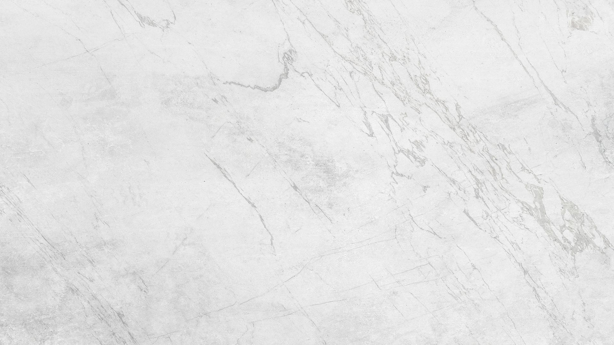

Introduction
目录
01
RRM vs Traditional Materials
02
RRM Development
03
04
Durability Testing
05
Urban Canyon Albedo Simulation
CONTENTS
06
Thermal Load Simulation
07
Conclusions
08
Future Work

Slide 3
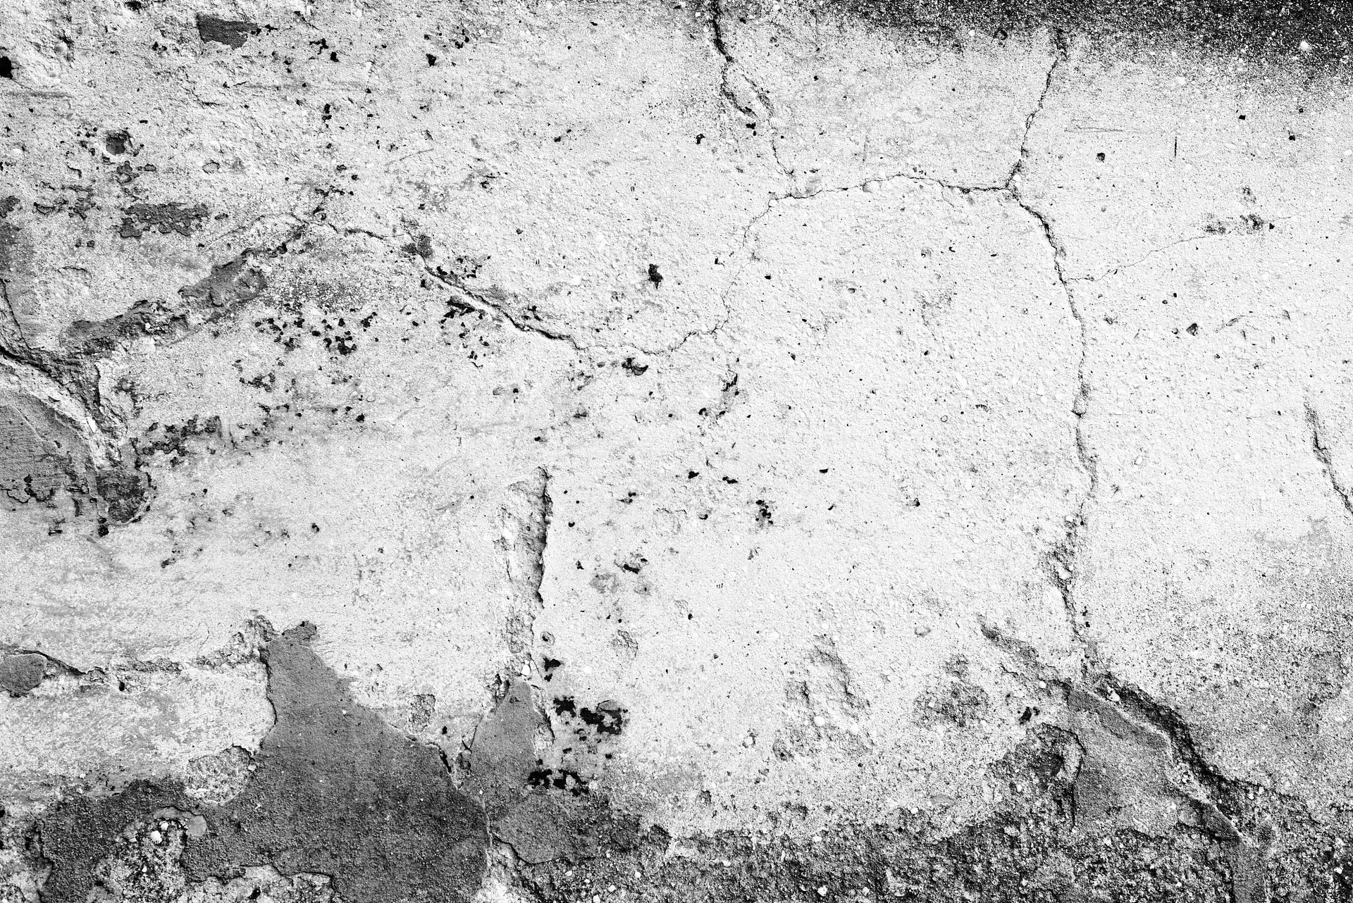
01
Introduction

Slide 4


Urban Heat Island Mitigation
Heat Emissions from Buildings
RRM Concept
Buildings contribute to ~50% of urban heat emissions, exacerbating urban heat islands. High solar reflectivity materials are essential for reducing cooling energy demand and improving air quality.
Retro-reflective materials (RRM) reflect light back to its source, unlike traditional diffuse reflective materials. This unique property can significantly reduce heat transfer to neighboring areas.

Slide 5
02
RRM vs Traditional Materials

Slide 6
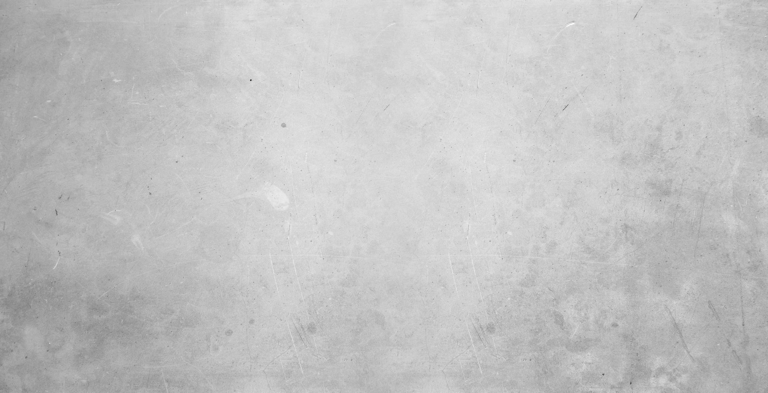

Reflection Mechanisms
Diffuse Reflection
Retro-Reflection
Diffuse reflection scatters light in multiple directions, leading to higher heat absorption by surrounding surfaces. This is less effective in reducing urban heat islands.
RRM reflects light back to its source, minimizing heat transfer to adjacent buildings and roads. This enhances urban canyon albedo more effectively.

Slide 7
03
RRM Development

Slide 8

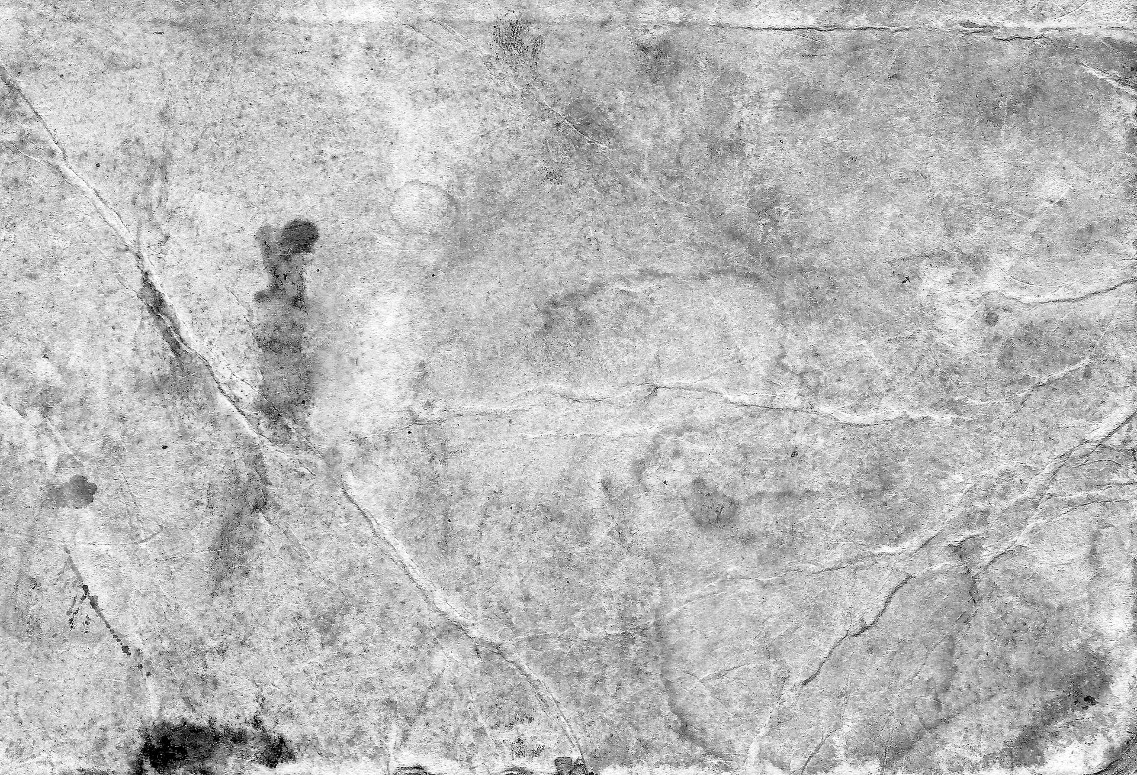
Material Composition
Glass Covering
The new RRM features a glass covering with high transmittance and strength, ensuring durability and high reflective luminance.
Plastic Micro-Prisms
Plastic micro-prisms with cubic corners replace traditional glass beads, providing a white appearance and strong UV resistance.

Slide 9
04
Durability Testing

Slide 10
Outdoor Testing Results
Solar Reflectance
Retro-Reflectance
After 485 days of outdoor exposure, the solar reflectance (ρ_{tmp}) remained at ~0.81, demonstrating excellent durability.
The retro-reflectance (ρ_{ret}) remained at ~0.44, with no surface degradation observed under a microscope.

Slide 11
05
Urban Canyon Albedo Simulation

Slide 12


Simulation Results
Albedo Comparison
A 2D model showed that RRM on both walls (Case C) achieved the highest urban canyon albedo, outperforming diffuse and mirror materials.
Impact on Urban Heat Islands
RRM effectively increases urban canyon albedo, reducing the urban heat island effect by reflecting more sunlight back to the source.

Slide 13
06
Thermal Load Simulation

Slide 14

Energy Savings
Cooling Load Reduction
Heating Load Increase
In Shanghai, buildings with RRM coatings experienced a 19% reduction in annual cooling loads, with cooling loads decreasing by 13-15% in summer.
Heating loads increased by 5-7% in winter, but the net annual thermal load reduction was 4.3%, with CO₂ emissions reduced by ~3.3 kg/m²-year.

Slide 15
07
Conclusions

Slide 16
Summary of Findings
Durability and Performance
Energy and Environmental Benefits
The developed RRM with a glass covering maintained high reflectance for over 485 days, outperforming other materials in durability tests.
RRM effectively reduces cooling loads and urban heat islands, with a net reduction in annual thermal loads and CO₂ emissions, making it a promising solution for urban environments.

Slide 17
08
Future Work

Slide 18

Research Directions
Extended Durability Testing
New Formulations
Real-World Applications
Continue testing RRM durability beyond 485 days to further validate long-term performance.
Develop additional RRM formulations to optimize performance and explore applications beyond vertical walls.
Conduct field testing in real urban environments to assess practical benefits and challenges.

Slide 19

THANKYOU
Date：2025.07.21
Reporter: Jihui Yuan

