Slide 1
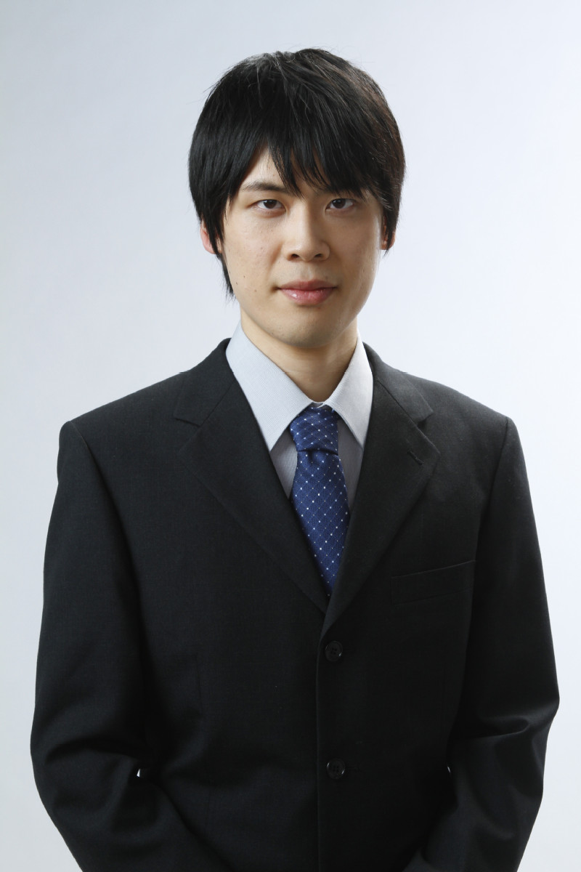
“Frontiers in Science” Seminar
Dr. Yohsuke Imagi
ShanghaiTech University, China
Title : Compact Calabi--Yau Conifolds
Date & Time : January 31, 16:00～17:00
Venue : Sci. Bldg., F415 (Sugimoto C.)
Abstract:Compact Calabi–Yaus conifods mean compact Calabi–Yau varieties with isolated singularities equipped withRicci-flat Kahler metrics decaying to cone metric at the singularities. There was a (rather old) project by Yat-Ming Chan who carried out (by the gluing method) some simultaneous smoothings and resolutions of Calabi–Yaus and special Lagrangians. This was rather too technical at that time because no examples of compact Calabi–Yaus conifodswere known. Examples have now been found by Hans-Joachim Hein and Sun Song (using the result of Donaldson--Song).I will try to give a more systematic version of Chan's project.
Contact : Yoshinori Hashimoto
Department of Mathematics
E-mail: yhashimoto[at]omu.ac.jp

Slide 2
Lecture Series ”Frontiers in Science”
Dr. Yohsuke Imagi
ShanghaiTech University, China
Title : Topics from Sheaf Theory
Date & Time : January 13, 13:15～14:45
January 14, 13:15～14:45
January 15, 13:15～14:45
Venue : Sci. Bldg. F408 (Sugimoto C.)
I am planning to choose topics from sheaf theory. This is a large area and I can cover only a few easy pieces of it. I assume that the audience is more or less familiar with classical cohomology groups H^*(X,k) of manifolds X with coefficients in a field k. Sheaf theory gives a universal way of defining the cohomology groups H^*(X,k). These are naturally isomorphic to the known cohomology groups defined using more explicit models, such as de Rham cohomology groups (with k=R) defined using differential forms. There are also sheaf theory definitions of Mayer--Vietoris exact sequences and Thom isomorphisms, which fit into commutative diagrams under the natural isomorphisms to de Rham or other known cohomology groups.
Contact : Yoshinori Hashimoto
Department of Mathematics
E-mail: yhashimoto[at]omu.ac.jp

